Slide 1
STRATEGY DECK
The Olist Marketplace
at an Inflection Point
Three strategic postures for a marketplace whose growth engine is misaligned with its retention economics.
Jared M. Grant
Companion to the Olist Marketplace Scenario Planner · jaredmgrant.com/tools/olist-forecast

Slide 2
THE QUESTION
How should a marketplace operator allocate spend when current trajectories point to contraction?
Olist's seller base reached 1,263 active sellers by August 2018, the end of the public dataset.
The estimated monthly exit rate across categories averages 33%. At observed marketing spend, baseline inflow replaces only about 130 sellers per month against 400 leaving. The seller base, on inertia alone, declines toward 500–600 within twelve months.
This isn't a growth question.
It's a question of capital efficiency through a structural reset.
Every scenario in this deck shows a smaller seller base twelve months out. What differs is how much that base costs to maintain, and what the marketplace looks like on the other side.
Source: Olist public data (Sep 2017 – Aug 2018) / scenario planner model.

Slide 3
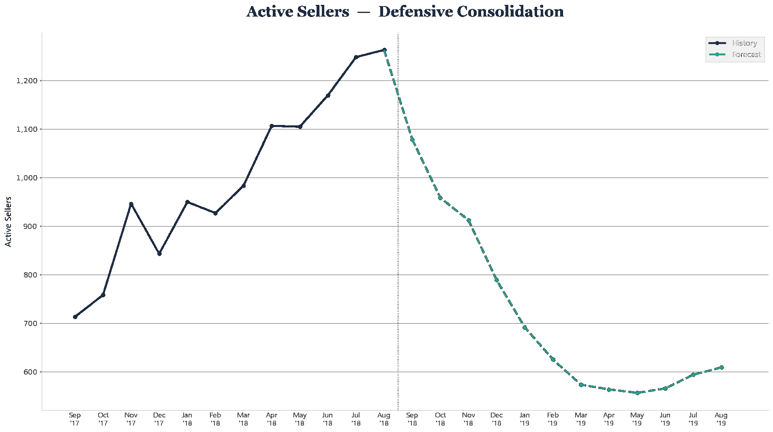
CURRENT TRAJECTORY
Do nothing, lose half the seller base.
Holding marketing at observed spend and freight subsidy at zero, the seller base falls from 1,263 to roughly 609 over twelve months. Revenue falls in parallel. This is the anchor scenario — what happens if no strategic move is made.
12-MONTH OUTCOME
609
ACTIVE SELLERS (MONTH 12)
down from 1,263
R$8.02M
CUMULATIVE REVENUE
12-month forecast
R$0
SUBSIDY COST
no freight subsidy
Source: Olist scenario planner, 12-month forecast at observed spend, all categories.

Slide 4
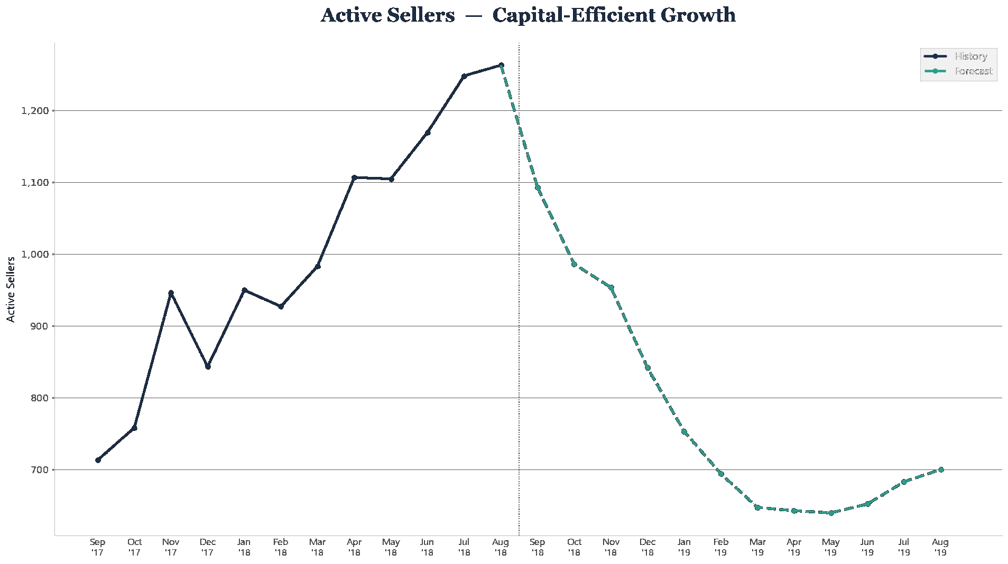
SCENARIO 1
Capital-Efficient Growth
Concentrate marginal marketing spend in the highest-elasticity channel — paid search — and don't subsidize freight. Accept a smaller revenue lift in exchange for the lowest cost per dollar of output.
PAID SEARCH
SOCIAL
OTHER CHANNELS
FREIGHT SUBSIDY
1.8x
1.0x
1.0x
0%
12-MONTH OUTCOME
700
ACTIVE SELLERS (MO. 12)
+15.0% vs. baseline
R$8.46M
CUMULATIVE REVENUE
+5.5% vs. baseline
R$8.46M
NET (REV − SUBSIDY)
+5.5% vs. baseline
THE TRADEOFF — +15% sellers and +5.5% revenue for the cost of an 80% paid-search increase. No subsidy expense. The capital-efficient path through the reset.

Slide 5
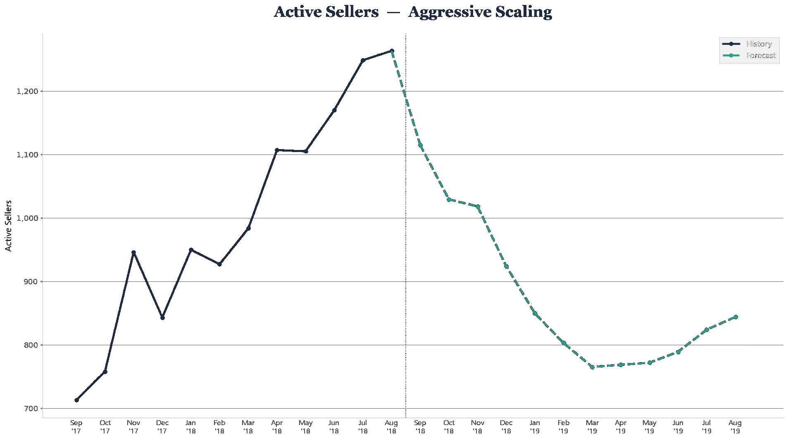
SCENARIO 2
Aggressive Scaling
Push every channel hard and subsidize freight at 20%. This is approximately the strategic posture Olist actually adopted — funded by Series C and Series D capital infusions in 2019–2021.
PAID SEARCH
SOCIAL
OTHER CHANNELS
FREIGHT SUBSIDY
2.5x
2.0x
1.5x
20%
12-MONTH OUTCOME
844
ACTIVE SELLERS (MO. 12)
+38.6% vs. baseline
R$9.39M
CUMULATIVE REVENUE
+17.1% vs. baseline
R$9.06M
NET (REV − SUBSIDY)
+13.0% vs. baseline
THE TRADEOFF — +39% sellers and +17% gross revenue, but ~24% of the revenue gain is eaten by subsidy cost. Net revenue lifts only 13%, while channel spend roughly doubles.

Slide 6
SIDE BY SIDE
Three postures, one structural reality.
Every scenario produces a smaller seller base at month 12. What separates them is the cost per incremental seller retained, and whether the spend leaves the marketplace stronger or just slows the bleed.
 | DEFENSIVE | CAPITAL-EFFICIENT | AGGRESSIVE
 | Baseline | 1.8x paid search | 2.5/2.0/1.5x + 20% subsidy
Active Sellers (Mo. 12) | 609 | 700 (+15%) | 844 (+39%)
Cumulative Revenue | R$8.02M | R$8.46M (+5.5%) | R$9.39M (+17%)
Cumulative Subsidy Cost | R$0 | R$0 | R$329K
Net Revenue (Rev − Subsidy) | R$8.02M | R$8.46M (+5.5%) | R$9.06M (+13%)
New Sellers Acquired | 1.7K | 2.0K (+15%) | 2.4K (+39%)
Observation: Aggressive Scaling adds 144 more sellers than Capital-Efficient — at a cost of R$329K in subsidy plus the multiplied channel spend. The cost per incremental retained seller climbs sharply with scale.
Source: Olist scenario planner, 12-month forecast, all categories. Deltas computed against Defensive Consolidation baseline.

Slide 7
RECOMMENDATION
Lead with capital efficiency. Earn the right to scale.
PRIMARY PATH
WHEN TO ESCALATE
Capital-Efficient Growth
Aggressive Scaling becomes defensible when…
Concentrate spend where the elasticity is identified.
Paid search shows the largest and most significant channel coefficient. Pushing it to 1.8x produces a +15% lift in active sellers and +5.5% revenue at no subsidy cost. The marketplace lands at month 12 with 91 more sellers than the do-nothing baseline, funded entirely by reallocation rather than new capital.
capital is available on terms that don't dilute the underlying unit economics (typically an external infusion);
the marketplace has a credible plan to reduce the 33% monthly exit rate — through onboarding, retention programs, or category-specific product investment;
the additional R$329K in subsidy cost is defensible against a strategic objective beyond pure output (signal to investors, category land-grab, defensive positioning against a competitor).
Bottom line: the model doesn't recommend more spend or less spend. It recommends spending where elasticities are identified and outcomes are accountable. Scale follows justification, not the other way around.

Slide 8
EX POST
What Olist actually did, and what the model would have anticipated.
2018
Dataset ends
1,263 active sellers, marketplace in apparent growth phase but with 33% monthly seller churn against baseline inflow of ~130.
2019
Series C — $46M
Led by SoftBank. Capital infusion enables the Aggressive Scaling posture in the model.
2021
Series D — $80M
Led by Goldman Sachs. Continued aggressive expansion. Olist Shops launches; logistics acquisitions begin.
2021
Series E — $186M
$1.5B valuation. Business model pivots beyond marketplace into fulfillment and financial services.
2022
Layoffs
Company cites the need to “grow efficiently” — the language of a business retroactively correcting toward the capital-efficient posture.
Sources: TechCrunch (2021); Bloomberg Línea (2022). Detail and citations on the live tool page.

Slide 9
METHOD & SCOPE
What this is — and what it isn't.
THE METHOD
THE SCOPE
A five-equation econometric system estimated on the public Olist dataset (Feb 2017 – Aug 2018, 64 categories × 19 months).
Two equations are estimated by within-group (fixed effects) panel OLS — new seller acquisition from marketing channel inflows, and unit output from active sellers, lagged output, price, and effective freight.
Three are identities — active seller stock evolves from inflow minus exits, revenue is output times price, and subsidy cost is the platform-borne fraction of freight times units.
Coefficients propagate forward in a recursive solve. Sliders move controllable inputs; the system updates in real time.
Much of the work in this project was in choosing relationships that reflect how the marketplace actually operates, not in tuning for predictive accuracy.
Price is treated as observed rather than as a lever — without demand-side structure, treating price as a control variable yields degenerate optimization.
Marketing channels are grouped into three because most have insufficient lead volume to identify separately. Cross-category substitution is excluded.
Applied to real organizational data, the framework expands to include actual cost structures, real spend rather than lead-count proxies, longer time series, and the organizational machinery that makes forecasting drive decisions.
Explore the model: jaredmgrant.com/tools/olist-forecast

Slide 10
THE FRAMEWORK
Dashboards describe what happened.
Forecasts describe what might happen.
Scenarios describe what should we do.
The Olist exercise is a public-data demonstration of a framework I apply to internal organizational data.
The real value isn't the model. It's the discipline of specifying which relationships are estimable, which inputs are controllable, and which outputs matter — then putting the result in front of a decision-maker who can move the levers.
Jared M. Grant · jaredmgrant.com

